Slide 1

Lecture 7: Multithreading
WRPV302: Advanced Programming
Dr Simone Beets
Notes:
How you can get a single program to do multiple tasks at the same time on the same computer
Do that using threads

Slide 2
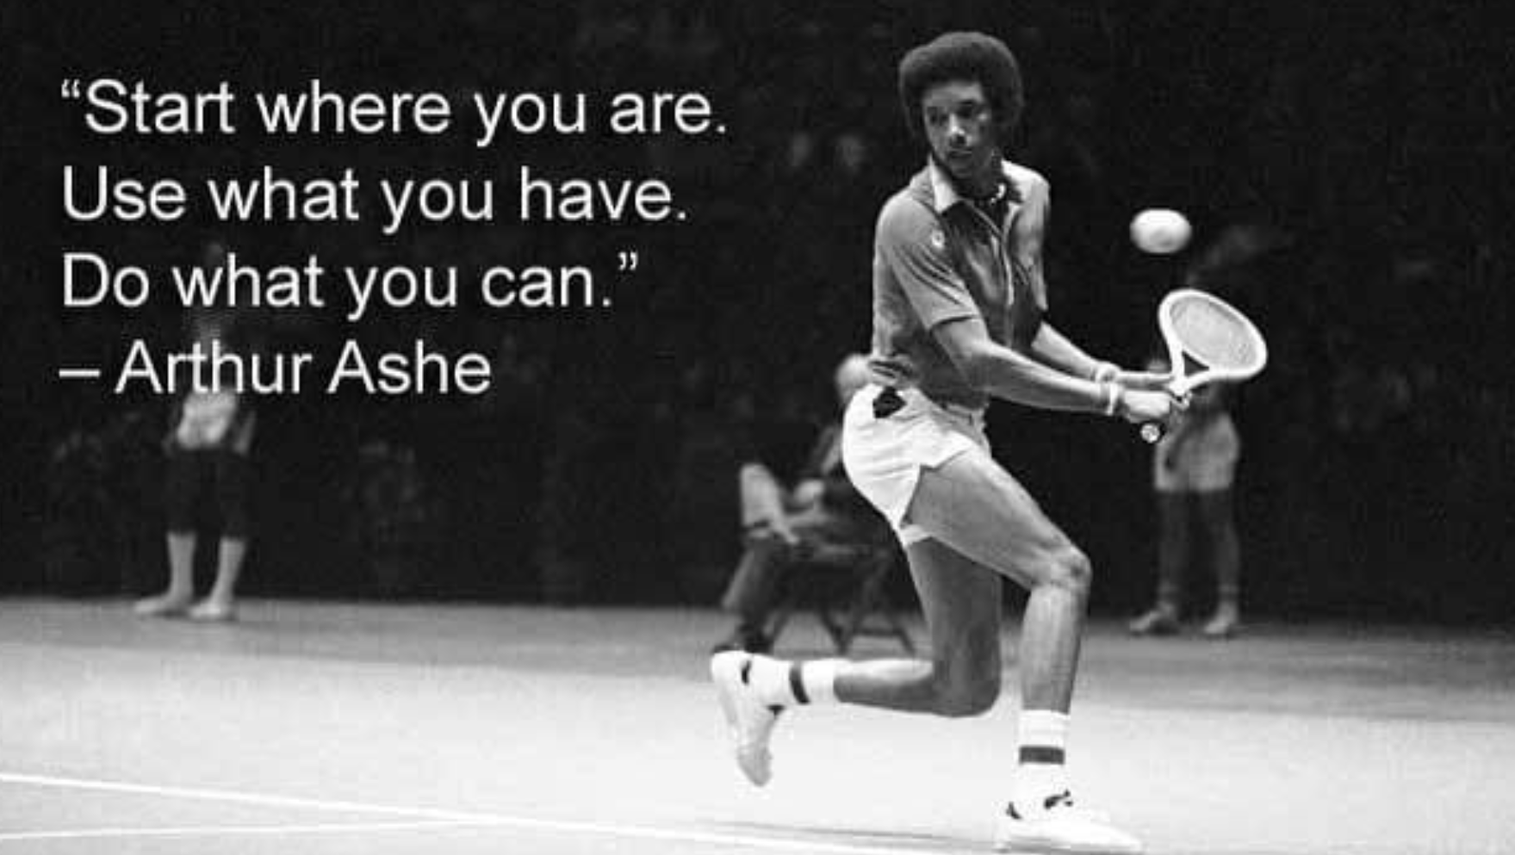

Slide 3
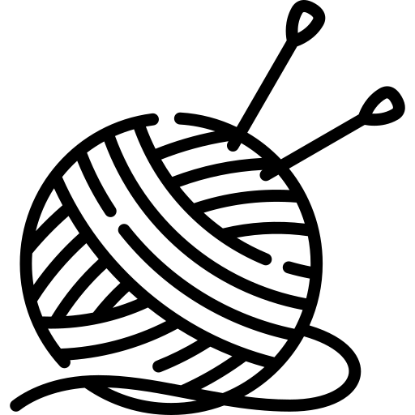
Threads
Notes:
https://www.flaticon.com/free-icons/knitting

Slide 4


Who has had an app freeze that you had to force it to close?
Notes:
Why do you think that happens?
Android terminates apps if the UI becomes unresponsive for 5 seconds
Why?
UI thread – handles what is on the screen (touches, updating text, animations, etc.)
Thread is stuck, maybe loading a large file, intensive calculation
Stops responding to you
Android watches for this & assumes its dead (after 5 seconds) & shows you the app not responding message
Must be a better way to handle this – threads, work in background, UI thread keeps the app alive & responsive

Slide 5
A program unit that executes independently of other parts of a program
What is a thread?
JVM & Android execute each thread for a short period of time, then switch to another thread
Notes:
While displaying something to the user on a screen, can do calculations, communication across network
Java & Android make use of threads
Done fast enough, appears that multiple pieces of code execute in parallel [on multiple cores (usual case), it might – some or all of threads distributed to different cores, so will be running in parallel, i.e., threads executing at the same time]

Slide 6
What is a task that you do daily where you multitask?
Notes:
Cooking, gaming & chatting
Eating and watching tv? Prepping for lecture, while trying to show my dogs I have no popcorn left
Driving & listening to music
Each of those activities are like a separate thread (happening in parallel, brain switching attention between them really quickly)
Just like the JVM does with CPU time
Tasks run at the same time – put something in oven, oven is doing work independently while you chop veggies
Like having multiple CPU cores

Slide 7

How are threads defined?
Implement Runnable interface or extend Thread class
Either way, need to write code for a run() method
  Code in the run() method will be run in parallel (using a Thread) once a thread has been started
If using first option of implementing the Runnable interface
  Allows you to use lambdas & other classes that do not extend Thread class directly, but it is a bit more work to set up
public interface Runnable {
void run();
}
Notes:
What type of interface? Functional interface with single method called run
Not for implementing all multithreading functionality, but provides a section of functionality that you would like to have run in parallel
Then: implementation of run method passed to thread
Two ways: create own class that extends Thread class, or implement as a lambda, implement runnable interface & pass to thread
Q: When use one over the other?
Runnable implementation:
Your class already extends another class (Java only allows single inheritance).
You want to separate the task from the thread running it (cleaner design, more reusable).
You plan to use the task with ExecutorService or thread pools.
Extend the thread class:
You want to customise the thread itself, not just the task (e.g., override other Thread methods like start(), set priorities inside the class).
You want quick, simple demo code (learning/teaching basics).
Rare in production, but sometimes useful for framework-level code.

Slide 8
How are threads started?
Implemented Runnable
wrap it in a thread object
Extended Thread
implement run method
then start() the thread object
instantiate it
then call start() on the thread object
Don’t do this…
Calling run() does not start a new thread, it simply calls the method (like a normal method) on the current thread
See /Example01
Notes:
Implementation of runnable functional interface
Need to call start() on thread object for the specific piece of code in the run method to be run in parallel
Don’t call the run() method, won’t run the code, will be treated as any other method, need to call start() on thread object

Slide 9
So, what is happening in Example 1?

Slide 10
So, what is happening in Example 1?
Example01
(Main Thread)
This bit will probably happen many times during the execution
PMR
(thread)
line 18: thread.start()
run() a bit
PMT
(pmThread)
line 24: pmThread.start()
run() a bit
waiting for all child threads to end…
run() a bit
run() a bit
Notes:
Started running program, created a thread in background that was running main program
Run normal until line 18
Thread.start()
Background – another thread of execution created in parallel to main thread
Java decides which threads get some time to execute
Maybe – new one – some of the code in the run() method given a chance to execute
Then, after some time, the scheduler decided it had enough time to execute
Control passed back to main thread to execute more of its code (19/20)
Up to 24
Another thread created, so a new thread of control was created (pmThread)
3 threads running in parallel
Scheduler picks one of them to run
Scheduler decides that it had enough time to run
Control passed to one of the other threads
Say, middle thread, some time to execute
Then another one
But middle at the end
Thread deleted
Two threads left
One gets a chance to execute (third)
Then done
Removed
One thread left, main thread
Given control, & run till end
Then the main program stop running

Slide 11
Main program thread
Garbage collection thread
What threads are in a typical Java application?
Screen updating thread
Event dispatching thread
Notes:
Encountered already
Main – first one that gets created
Others are child threads that belong to it
Garbage Collection
Created objects & not using, after some time, Java collects all objects & frees the memory that they use as a batch
Might not want this – might want more control (say if a real-time app), if running smoothly, then lag
GC could be the cause
Screen updating – create UIs (JavaFX & Android have a specific thread for updating UI & keep smooth interaction with the user)
Event dispatching
Clicking on buttons, a thread in the background that collects events & distributes to specific listeners that are interested in them

Slide 12
How does the JVM decide which thread to execute?
Co-operative
Pre-emptive
Time-slicing
Multiprocessor
No sharing of resources
Threads have priority
Every thread gets some resource time
Each thread runs on its own processor
Notes:
CO:
Each thread cooperates with other threads to share the CPU
Execute for a period of time
Each piece of code runs on the CPU (no issues & informs that used enough, release hold, let other threads use it)
Assumption: all processes are well-behaved
BUT: Not work that well, if methods don’t release CPU, hog CPU, other threads don’t have a chance
Earlier versions of Windows; could crash everything
Not the way to go
PE:
Thread with certain priority would run, & if another thread was created with higher priority
Pre-empt current thread
Take over & run
Finished, release, next highest priority thread would run
Priorities, everyone wants to be a high priority,
Lead to sluggish performance
TS:
CPU time divided into time slots
Each thread is allocated a time slot in sequence over time to run
Diff to CO, if time is up, CPU forcefully taken away, another thread given a chance
MP:
Allowing a thread to run on a different processor
4 proc, 4 threads running, each thread runs on a different processor

Slide 13
Can set a priority, which indicates how important a thread is
  Using t.setPriority(Thread.MIN_PRIORITY);
A higher priority thread has preference over a lower priority thread
  BUT the VM will still give all (even lower priority) threads a chance to execute
Threads of the same priority are “randomly” picked to be executed
Can we change how frequently a thread is executed?
Yes…!
Notes:
Java uses time-slicing to share CPU among diff threads on same CPU (distributes to other CPUs if necessary)
If thread more frequently on a specific CPU
Can set a priority
Different ones – numbers (higher number, higher priority)
If all high, then no real priorities, then randomly select

Slide 14
Creating new threads takes time
  i.e., create threads when timing is not important
Switching between threads takes time
  i.e., don’t have too many threads or the efficiency drops
Destroying threads also take time
Are threads efficient?
If you need many, short-lived threads, use the ExecutorService to reuse threads
See /Example02
Notes:
Why can’t we just use them everywhere?
Overhead in what is happening in the background
VM – allocated resources to run things in parallel
When creating threads is important
Every time a thread is stopped by the scheduler, the scheduler must remember its state, store it, pick another thread, restore context, run, etc.
Fewer threads on the same CPU, the amount of time a thread can be run can be longer
Swaps less → saving & restoring time is smaller
Creating & destroying threads takes time
Many threads → lots of time swapping between contexts
ExecutorService
Manage creation & destroying time of threads
Instead of creating & destroying, it will reuse threads
An example of where you might want to use an ExecutorService?:
1) Building a chat server,
Every time a client connects, need a thread to handle their messages
Clients connect & disconnect all the time, so threads are short-lived
Where you might want to use executor service
2) Android app needs to download 100 thumbnail images for a gallery
Each download is quick, but spawning 100 threads to grab each one is wasteful
ES: queue them up & let 5-10 threads handle downloads efficiently
Just like in life, if try to do too many things at once, performance suffers, true for threads – powerful, but switching between them costs time

Slide 15
Reach the end of the run method
Interrupt it using t.interrupt()
Stop it using t.stop()
How do we stop a running thread?
Run method should check if interrupted, using
Thread.interrupted();
If a thread is sleeping, interrupting it throws an exception:
InterruptedException
Notes:
Start, run, sleep, use pool to share threads
Run method complete
Stop, deallocated from memory, etc.
Error condition, stop it → exception thrown, code in run method given chance to catch exception & handle it (connecting to database, rolling back operations or closing database, etc.)
Stop: hard stop on thread, not scheduled for execution

Slide 16
public class DebugThreads {
public static void main(String[] args) {
Thread worker = new Thread(() -> {
System.out.println("Worker running on: "
+ Thread.currentThread().getName());
});
}
}
Will the worker thread run in parallel with this code?
Notes:
Well, no, no method call to run it
.run() → doesn’t start a new thread, but will execute the code immediately on the current main thread, like a normal method call
Code does run but only on the main thread, not in parallel
.start() → creates a brand new thread, which executes the run() method code in parallel with the main thread
Don’t call - Thread never runs at all
Call – spins up a new thread & runs the code independently
None → nothing happens at all

Slide 17
public class DebugThreads {
public static void main(String[] args) {
Thread worker = new Thread(() -> {
System.out.println("Worker running on: "
+ Thread.currentThread().getName());
});
worker.run();
}
}
❌
✅ worker.start();
Will the worker thread run in parallel with this code?
Thread.currentThread().getName()
main
❌
✅ Thread-0
Notes:
So we say worker.run()
Correct?
.run() → doesn’t start a new thread, but will execute the code immediately on the current main thread, like a normal method call
Code does run but only on the main thread, not in parallel
Thread.currentThread().getName()
.start() → creates a brand new thread, which executes the run() method code in parallel with the main thread
Don’t call - Thread never runs at all
Call – spins up a new thread & runs the code independently

Slide 18
Dashed shapes not actual states, i.e., cannot be retrieved by getState() method, but helps explanation
Thread lifecycle
Runnable
New
run() exits
or stop()
Terminated
Ready
to Run
scheduled to execute
Running
start()
suspended
acquiring
a lock
waiting for
timeout
waiting for
notification
Blocked
Waiting
Time
Waiting
Non-Runnable
acquired lock
notified
time up
Notes:
getState() method, enum value, tell you what the state was
New thread, thread in new state (new state)
Thread is created
Not started running in parallel yet
Waiting to be run
Call the start method
Thread goes into a runnable state
The thread may be run when told
Started → ready to run state (dashed – runnable state not ready to run)
Scheduler has threads ready to be run
Selects a thread in the runnable state
Schedule to be executed
Then the thread will run, executed for a period of time
When time is up, the thread will be suspended → ready to run state (back in the pool)
Scheduler will pick another thread (& repeat)
Code in the run method finished, or stop called
Thread not runnable, removed from pool
Terminated
Not considered for running again
While runnable
Acquire lock (later)
Waiting for notification (just now)
Waiting for timeout (already seen)
Thread.sleep() → Time waiting state
3 states → not runnable, not considered for selection
When time is up, put back into a runnable state, the thread can be selected to run again
If waiting → can be notified what they are waiting for, go back into runnable (same for lock)
Guess: difference between waiting and blocked?
Blocked: (standing in line for the bathroom)
when it’s waiting to get access to a resource, like a file or a database.
It wants to run, but something else has control of that resource
Waiting: (gone to your room & said wake me up when dinner is ready)
Deliberately put to sleep until another thread signals it
Calling wait() on an object
Not competing for a resource, paused until told otherwise

Slide 19


Timers & Animations using Threads
Notes:
https://www.flaticon.com/free-icons/animation
https://www.flaticon.com/free-icons/timer

Slide 20
Timers & animation
Separating time-consuming calculations from UI to keep UI responsive
Performing complicated calculations on different CPUs
Communication (network, database, etc.)
  Dealing with multiple clients simply (& as needed)
What can threads be used for?
Notes:
Perform specific tasks periodically at set time intervals (look at this one)
Create a stopwatch – task performed after period of time
Animations – animate part of UI (focus on specific parts of screen, causing colour changes, opening/closing drawers)
Android – useful as Android kills the app if it becomes non-responsive
Run in parallel, calc process faster

Slide 21
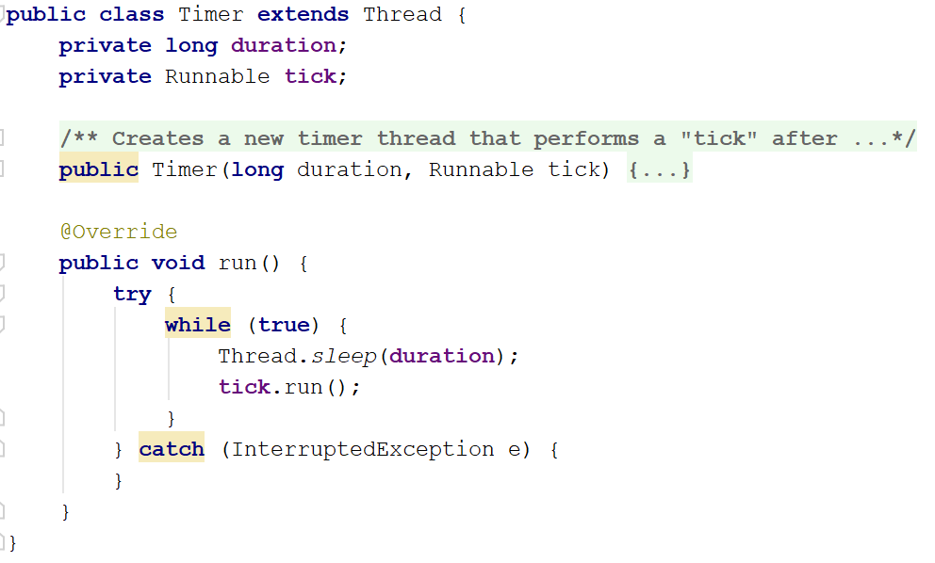
Timers
Definition
Typical structure
Thread that executes code at regular intervals
Notes:
Different types:
perform same task at regular periods,
stopwatch (executes code once after certain time)
Similar – here timer
Extend thread class
Pass duration, something implementing runnable
Started the timer, sleep for a period of time
After time, run the piece of code passed in from the runnable implementation
Sleep for a while, run code, in an infinite loop until told to stop or interrupted

Slide 22
Using threads for animation
Use a thread’s run() method to make changes to an animated object
  Usually use an infinite loop (pause, modification, draws, etc.)
Can only draw on the UI thread
  So need to call Platform.runLater() so this can happen
  Pass through drawing code that will be called later on the UI thread, when the UI thread is running
  Only seems to be necessary if many threads are trying to draw on the UI at the same time
See /Example03
Notes:
Changes build up into animation – change colour of control from one colour to another, moving something around
JavaFX & Android only on UI thread
If multiple threads, one drawing on screen, before done, another thread starts
Strange interactions

Slide 23

Two ways…
Each object animates itself
  Each object contains their own thread
  Use a thread in the main class to control updating & drawing itself
How do you animate multiple objects at the same time?
But…
Excessive resource usage
Objects can get out of sync, so how do we clear the background once per frame?
See /Example04
Notes:
Multiple balls bouncing on a screen
Thread per object that is animated (per ball)
Not best way
Efficient as long as don’t overuse (imagine 1000+ balls = 1000 threads running at same time)
Out of order – ball 1, 2, 3, 2, 3, 1…
Some move faster than where they should be
Don’t want to see what was there previously – clear all background, draw all balls for one step, then clear again. When do we clear the screen?

Slide 24

Two ways…
Single object controls all
  Single thread, updates all objects
How do you animate multiple objects at the same time?
Why use this method?
More efficient resource usage
Can control when background clearing occurs
Timing synchronised
See /Example05
Notes:
Better way
Sync issue…
Update all balls, draw all on screen
Only one thread drawing & updating balls at one time (1000 balls, 1 thread for drawing & moving)
Because one thread…
All balls moved forward one step in time before being drawn

Slide 25
Custom views
Extend View class
Override onDraw method to draw text, lines, circles & images (uses a Canvas class)
Provide 1-, 2- & 3- param constructors (inherited from View class)
  public View(Context context)
  public View(Context context, AttributeSet attrs)
  public View(Context context, AttributeSet attrs, int defStyle)
Once done, can drag & drop onto the layout from the Custom View tab (select the CustomView control)
See /L0701Threads01
Notes:
Creating bouncing ball
But if Android?
Create a custom view that extends the View class
For particular iteration (called automatically when it decides it is necessary to draw a view)
Can manually tell it too
Invalidate method
As if it is a normal control

Slide 26
Background data loading in a GUI (recipe app fetching ingredients from a db & user browsing at same time)
Periodic tasks / timers (auto-saving progress every 5 min)
Network requests (fetching chat app messages)
Real-time updates / monitoring (stock prices or game scores in real-time)
Where can you use threads in your third year / side project?
File I/O operations (exporting large CSV files)
Parallel processing for efficiency (rendering parts of a graphic scene concurrently)
Computationally intensive tasks (large dataset or simulations)
Handling multiple user requests (multiplayer games or chat server)

Slide 27
Assignments & tasks
Assignment 2:
Peer reviews – Due today
Assignment 3:
Due – 08 September 2026
Peer reviews – By 11 September 2026
Assignment 4 will be uploaded this week

